Slide 1

The Economic Case for Immigration with Regards to Refugees
Created By Gary Yu
ECON Student
BA in Political Science: with a specialty in International Relations

Slide 2
Introduction
As of 2021 there are about 332 million people in the United States according to the US Census Bureau.¹
Of those in 2018 there were 44.8 million immigrants. According to Pew Research who got it from… the US Census Bureau.²
The US State Department/US Government has already admitted 3.1 million refugees since 1980.³
Overall, in the past decade in the US, 28 percent of refugees have been from Africa, 63 percent from Asia, 5 percent from Europe, and 4 percent from Latin America/the Caribbean.⁴

Slide 3
Why Should the US bring in refugees?
A few reasons have been given; I agree with some of these
Geopolitics/Foreign Policy; Matthew Yglesias, Basically the US needs more people so it can remain the global hegemon vs China and India for democracy, and rule of law plus economic growth in the world. Also, you can add US soft power to this as well. ⁵
Economic potential: Bryan Caplan an economist thinks we should have open borders so that we can fight to get more people who are a commodity to which we can produce economic growth in the US.⁶
Moral/UN perspective: Refugees face serious harm in their countries and must be safe in another country or area.⁷
Modern Statue of Liberty: The US should take in the oppressed/masses of the world because no one else will do it, and so they can be free.⁸
Climate Change: Vaush a streamer argues we should use refugees to build massive public works projects to counter climate change.⁹

Slide 4
My Reason
Refugees according to my personal experience are the most disliked of the immigrants' groups, generally I feel like in our society in terms economic usefulness it’s
Rich investor> H1B(skilled immigrants)> family migration > undocumented workers > refugees
I generally want more immigrants, and I have a habit of attacking the strongest part of an argument
Generally, I think having more people in the right place will create solutions to many problems, and the US is a right place.

Slide 5
My Two Papers
I read two papers on refugees
The Economic and Social Outcomes of Refugees in the United States: Evidence from the ACS¹⁰
“However, most economic outcomes such as employment and earnings improve as refugees age in the country, while enrollment in government transfer programs tends to decline considerably over the same period.”
“However, we also find that refugees who arrived as children of any age have much higher school enrollment rates than U.S.-born respondents of the same age. As a result, observed differences in high school graduation between refugees and natives observed at ages 19-24 disappear when we examine them 10 years later.”
The other on integration of refugees in wealthy western countries (EU, US, Canada) ¹¹
Over the long term, among refugees who entered at a young age, positive economic assimilation occurred quickly; but this was not the case for refugees who arrived at older ages.

Slide 6
Where I got my data from
New Annual Survey of Refugees (ASR) 2018 (2020 not available for public use) ¹²
^{“1,500 completed interviews”}
“An overall response rate of 21 percent was achieved”
“The overall response rates decreased with time since arrival to the U.S., varying from 17 percent for FY 2013-14 refugees to 23 percent for FY 2015-16 refugees and a high of 25 percent for FY 2017 refugees”
“The 2018 ASR targeted 1,500 completed interviews from refugee households entering the U.S. between FY 2013-2017”

Slide 7
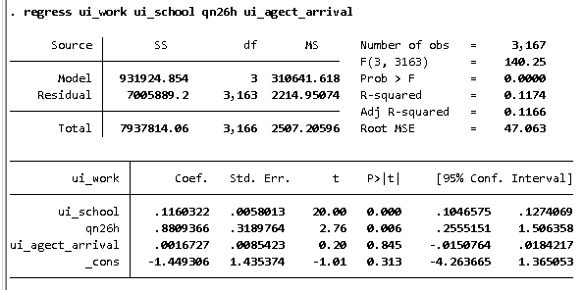
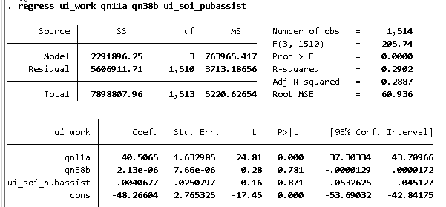
OLS regression
Key:
ui_school: adult’s educational pursuit in US
qn26h: If they help in child’s education
ui_agect_arrival: Their age when arriving in the US
Key:
qn11a: Prior history of working
qn38b: House or apartment
ui_soi_pubassist: Do they use public assistance

Slide 8
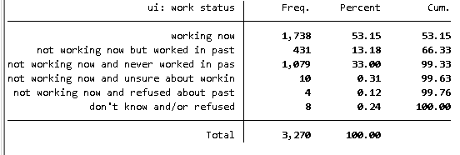
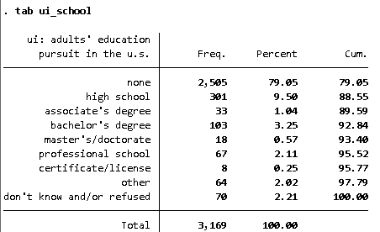
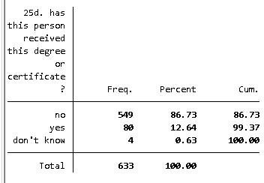
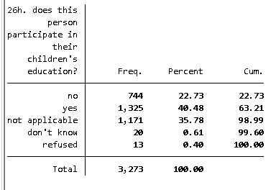
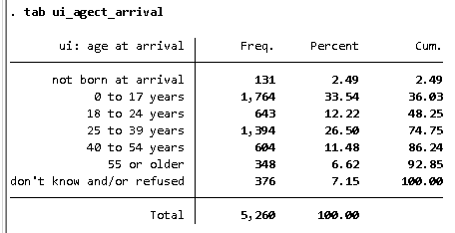
More Data about refugees

Slide 9
Counter-arguments
More people more problems; How are you going to maintain the US welfare state to help all those refugees.
Answer: It’s a medium-term investment, but refugees are generally very productive after a period as evidence by the facts stated on this presentation.
Abandon of towns, cities, regions, maybe whole countries: What if some places are left without young people, working people, etc.
Answer: Reverse brain drain would be the solution; they could entice people from wealthily nation via less expensive cost of living.
Increase COL in US. What if more people means increased housing costs.
Answer: Building more housing to meet the market’s demand via subsides, etc., also many of refugees want lower housing costs as well, and will fight for it on an economic, and political level.
America is full: We have too many people already.
Answer: The US isn’t full, and our carrying capacity is not overburden. We could easily through scalable technology have a billion people or more thanks to favorable US geography.
Automaton means we don’t need as many people.
Answer: We likely still need consumer data and without young people who drive the culture, your country could be less dynamic.

Slide 10
Analysis of Data
I ran an OLS regression, and tabulate data of refugee economic impact using Stata, and here’s what I got…
Most refugees like adults who can work will work.
Those who can’t work such as homemakers/caretakers, children, students, are doing so in a way to enhance future US human capital.
Refugees with children are more likely to work.
Refugees who have gotten training/certifications/degrees will also be more likely to work.
Age of arrival is likely correlated with working, and likely English speaking/writing/reading ability.

Slide 11
Conclusion
Refugees if brought in as kids tend to be as or more productive than locals in the US.
While the language barrier remains a problem as time goes on refugees use less welfare state resources and are more productive.
Refugees while generally needing more state investment are just as productive as other human capital inputs.
It’s very likely that the competition to get young people within your borders for various reasons(welfare state, geopolitical, public works) will be relevant depending on various factors(automaton, AAI, AI for example), but even as consumers refugees could have a part to play in data driven economies.

Slide 12
Chicago Style NB Citations
“U.S. Census Bureau Quickfacts: United States.” United States Census , July 1, 2021. https://www.census.gov/quickfacts/US.
Budiman, Abby. “Key Findings about U.S. Immigrants.” Pew Research Center. Pew Research Center, September 22, 2020. https://www.pewresearch.org/fact-tank/2020/08/20/key-findings-about-u-s-immigrants/.
“Refugee Admissions - United States Department of State.” U.S. Department of State. U.S. Department of State, October 8, 2021. https://www.state.gov/refugee-admissions/#:~:text=Since%20the%20passage%20of%20the,more%20than%203.1%20million%20refugees.
Jeanne Batalova Kira Monin, Jeanne Batalova. “Refugees and Asylees in the United States.” migrationpolicy.org, July 8, 2021. https://www.migrationpolicy.org/article/refugees-and-asylees-united-states-2021#:~:text=Overall%2C%20in%20the%20past%20decade,from%20Latin%20America%2Fthe%20Caribbean.
Yglesias, Matthew. One Billion Americans. Penguin Publishing Group, 2020.
Matthews, Dylan. “The Case for Open Borders.” Vox. Vox, September 13, 2014. https://www.vox.com/2014/9/13/6135905/open-borders-bryan-caplan-interview-gdp-double.
“The 1951 Refugee Convention - UNHCR.” UNHCR. Accessed April 11, 2022. https://www.unhcr.org/1951-refugee-convention.html.
Lazarus, Emma. “The New Colossus by Emma Lazarus - Poems | Academy of American Poets.” Poets.org. Academy of American Poets. Accessed April 11, 2022. https://poets.org/poem/new-colossus.
Kochinski , Ian. “Vaush Talks about Climate Change.” Youtube, May 21, 2021. https://www.youtube.com/watch?v=KGj2sCJBxKI.
Evans, William N., and Daniel Fitzgerald. “The Economic and Social Outcomes of Refugees in the United States: Evidence from the ACS.” NBER, June 12, 2017. http://www.nber.org/papers/w23498.
Feinstein, Scott, Cristina Poleacovschi, Riley Drake, and Leslie Ann Winters. “States and Refugee Integration: A Comparative Analysis of France, Germany, and Switzerland - Journal of International Migration and Integration.” SpringerLink. Springer Netherlands, January 7, 2022. https://link.springer.com/article/10.1007/s12134-021-00929-8.
“Introducing the New Annual Survey of Refugees (Asr) 2020.” The Administration for Children and Families, March 9, 2021. https://www.acf.hhs.gov/opre/blog/2021/03/introducing-new-annual-survey-refugees-asr-2020.

